Slide 1
1- point perspective project

Slide 2
review
Forms are angled toward a single vanishing point in the distance
Draw front of object first
Connect sides to vanishing point

Slide 3
Project: interior spaces

Slide 4
Project: interior spaces

Slide 5
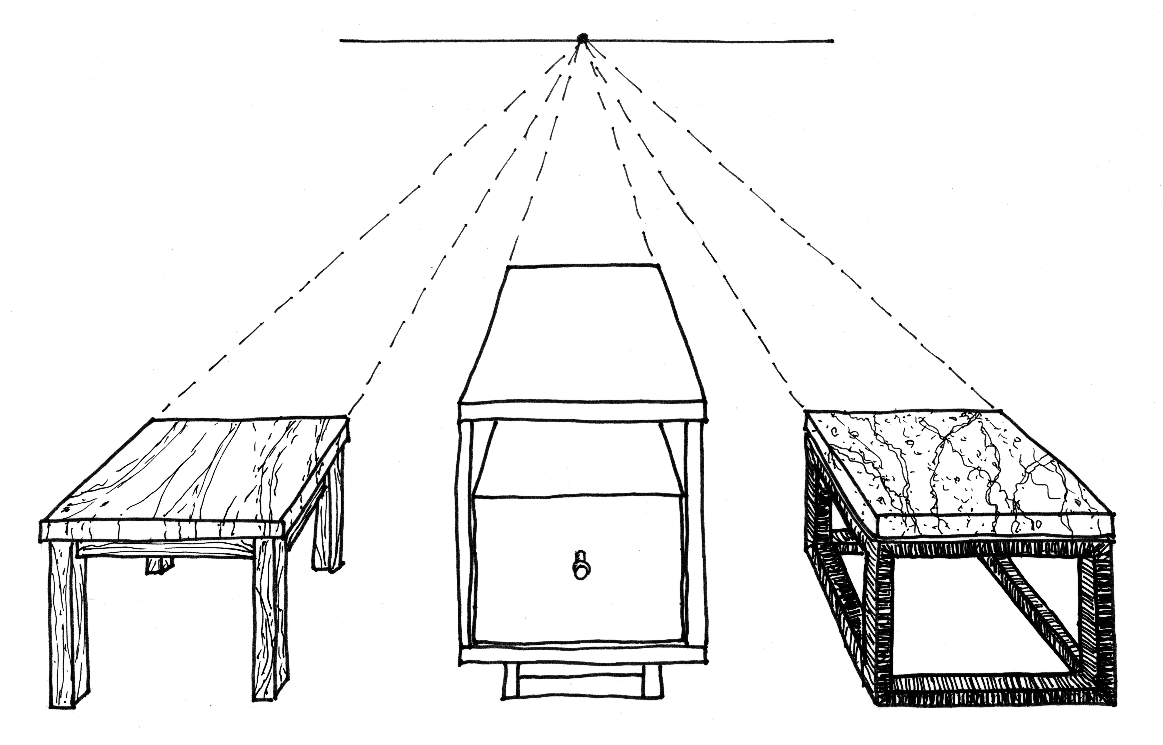
Project: interior spaces

Slide 6
requirements
20+ total objects
10+ objects angled toward vanishing point
All straight lines drawn with ruler
Creative approach
Fully shaded or colored

Slide 7
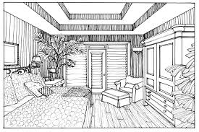
requirements
20+ total objects
10+ objects angled toward vanishing point
All straight lines drawn with ruler
Creative approach
Fully shaded or colored

Slide 8
requirements
20+ total objects
10+ objects angled toward vanishing point
All straight lines drawn with ruler
Creative approach
Fully shaded or colored

Slide 9
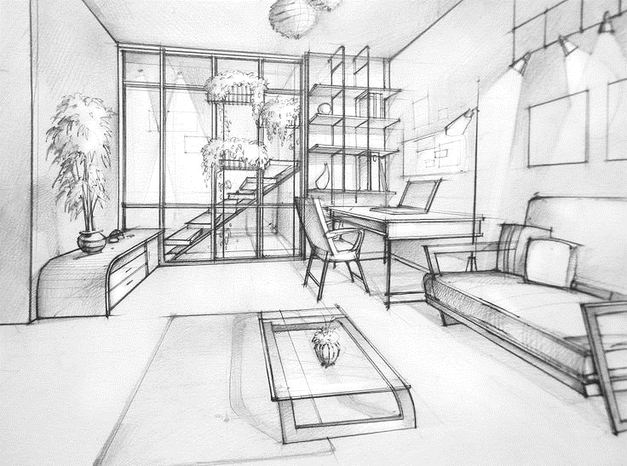
requirements
20+ total objects
10+ objects angled toward vanishing point
All straight lines drawn with ruler
Creative approach
Fully shaded or colored

Slide 10
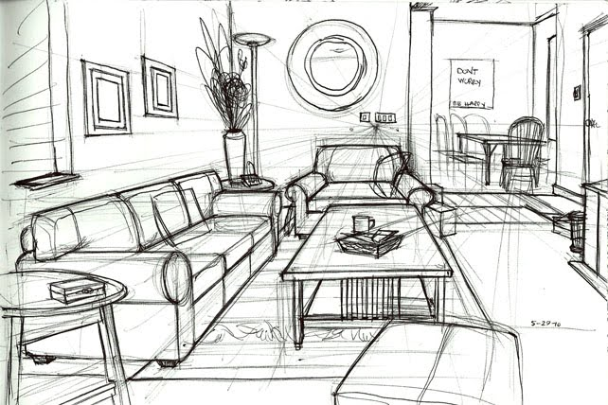
requirements
20+ total objects
10+ objects angled toward vanishing point
All straight lines drawn with ruler
Creative approach
Fully shaded or colored

Slide 11
requirements
20+ total objects
10+ objects angled toward vanishing point
All straight lines drawn with ruler
Creative approach
Fully shaded or colored

Slide 12
requirements
20+ total objects
10+ objects angled toward vanishing point
All straight lines drawn with ruler
Creative approach
Fully shaded or colored

Slide 13
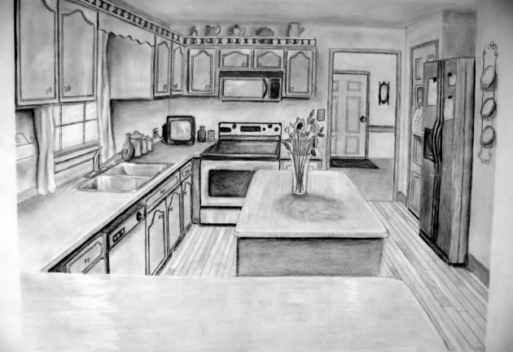
requirements
20+ total objects
10+ objects angled toward vanishing point
All straight lines drawn with ruler
Creative approach
Fully shaded or colored
Fully shaded

Slide 14
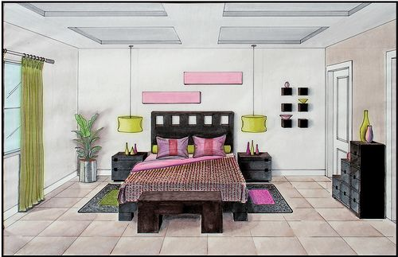
requirements
Minimum 10 objects angled toward vanishing point
10+ additional objects to personalize
All straight lines drawn with ruler
Creative approach
Fully shaded

